Slide 1
Credit One: Loan Approval Prediction
Jasmina Trbakovic

Slide 2
GOALS
Credit One as a credit scoring service has seen an increase in customers that defaulted on their loans.
Examine current customer demographics to better understand what attributes might relate to whether or not a customer is likely to default on their current credit loan(s).
There are numerous factors that determine if someone should be approved for a loan and how much of a credit to approve them for.

Slide 3
BADIR FRAMEWORK
Business Question – Analyze customer demographics to understand what attributes might relate to whether or not a customer is likely to default on their current credit loan(s). Also, determine how much credit to allow customers to use or if they should be approved or not.
Analysis Plan - Analyze the dataset using Python, related data analytics and machine learning libraries to predict patterns in customers that default and in those that do not default.
Data Collection - Data set was retrieved from Credit One MySQL database, which is a third party credit rating company that provides customer credit approval services to Blackwell.
Insights – What are the traits of an individual that defaults on a loan? Inspect the data to detect any obstacles and if there are any unexpected patterns in key variables.
Recommendation - Determine the type of customer we can recommend to Credit One and who should be approved for a loan and who should not be.

Slide 4
THE DATA
Credit One dataset consists of 30,000 customers with a credit line in the last six months and 25 variables in total. Available customer attributes include gender, education, marital status and age.

Slide 5
DATA MANAGEMENT
Data will be analyzed and managed using Jupyter Notebook to frame a predictor model by using pre-processing methods such as imputing missing values, variable names, data types and applying the model on training data set and evaluate the performance of classification algorithms like Decision Tree and Random Forest.

Slide 6
ISSUES WITH THE DATA
The data is large and contains some missing values. This will be resolved using Pandas. By cleaning the data, we make it ready for analysis with tools and methods provided. Converting data types and removing duplicate values will provide more accurate results which will benefit Credit One.

Slide 7
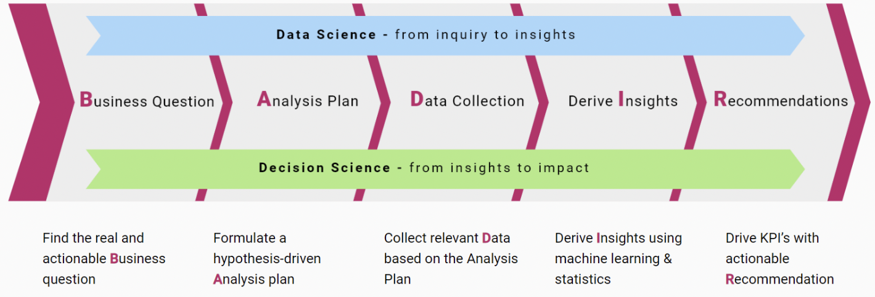
FLOWCHART

